Slide 1


Carol F.
Sept 9th 2024

Slide 2

Outline
Executive Summary
Introduction
Methodology
Results
Conclusion
Appendix

Slide 3
Executive Summary
Summary of methodologies
Data Collection through API
Data Collection with Web Scraping
Data Wrangling
Exploratory Data Analysis with SQL
Exploratory Data Analysis with Data Visualization
Interactive Visual Analytics with Folium
Machine Learning Prediction
Summary of all results
Exploratory Data Analysis result
Interactive analytics in screenshots
Predictive Analytics result

Slide 4
Introduction
Project background and context
The fact that Space X can reuse the first stage of the Falcon 9 rocket saves a significant amount of money; other companies charge upwards of 165 million dollars for each launch. Space X promotes Falcon 9 rocket launches on its website for 62 million dollars. Thus, we can calculate the cost of a launch if we can ascertain if the first stage will land. This data may be utilized should another business wish to submit a bid for a rocket launch against Space X. The project's objective is to build a machine learning pipeline that can forecast whether or not the initial stage will land successfully.
Problems you want to find answers
What operational circumstances must exist in order to guarantee the success of the landing program.
What elements influence the rocket's likelihood of a successful landing?
The way different features interact to determine the likelihood of a successful landing.

Slide 5

Section 1

Slide 6
Methodology
Executive Summary
Data collection methodology:
Data was collected using SpaceX API and web scraping from Wikipedia.
Perform data wrangling
One-hot encoding was applied to categorical features
Perform exploratory data analysis (EDA) using visualization and SQL
Perform interactive visual analytics using Folium and Plotly Dash
Perform predictive analysis using classification models
To build, tune, and evaluate classification models, split the data, train the model, tune hyperparameters, and assess performance using relevant evaluation metrics.

Slide 7
Data Collection
Describe how data sets were collected
Data was collected by sending a GET request to the SpaceX API.
The response was processed as JSON using the .json() method, then converted into a pandas DataFrame with .json_normalize().
We cleaned the data by addressing missing values as needed.
Additionally, we used BeautifulSoup to scrape Falcon 9 launch records from Wikipedia.
Our goal was to extract the launch records from an HTML table, parse them, and convert them into a pandas DataFrame for further analysis.

Slide 8

Data Collection – SpaceX API
We collected data from the SpaceX API using a GET request, then cleaned and performed basic data wrangling and formatting on the retrieved data.
The link is attached below: https://github.com/carolfu360/IBM-Tools-for-Data-Science

Slide 9

Data Collection - Scraping
Using BeautifulSoup, we used web scraping to gather Falcon 9 launch records. The table was parsed, and a pandas dataframe was created.
The link is attached: https://github.com/carolfu360/IBM-Tools-for-Data-Science

Slide 10
Data Wrangling
We identified the training labels by doing an exploratory data analysis. We determined the quantity of launches at every location as well as the quantity and frequency of each orbit. From the outcome column, we generated the landing outcome label and exported the data to CSV.
The link to the notebook is attached: https://github.com/carolfu360/IBM-Tools-for-Data-Science

Slide 11
EDA with Data Visualization
The relationship between the flight number and the launch site, the payload and the launch site, the success rate of each orbit type, the flight number and the orbit type, and the annual trend of launch success were all visualized as we investigated the data.
The link to the notebook is attached: https://github.com/carolfu360/IBM-Tools-for-Data-Science

Slide 12
EDA with SQL
We conducted extensive Exploratory Data Analysis (EDA) using SQL to derive key insights from the dataset. Our SQL queries allowed us to:
Identify the distinct launch sites involved in the space missions.
Calculate the total payload mass carried by NASA's CRS boosters.
Determine the average payload mass transported by the F9 v1.1 booster version.
Analyze the total number of successful and failed mission outcomes.
Investigate failed landing outcomes on drone ships, identifying the corresponding booster versions and launch site locations.
The link to this notebook is attached: https://github.com/carolfu360/IBM-Tools-for-Data-Science

Slide 13
Build an Interactive Map with Folium
We mapped all launch sites and incorporated interactive map elements, such as markers, circles, and lines, to visually indicate the success or failure of launches at each site using Folium.
Launch outcomes were categorized into binary classes, with 0 representing failures and 1 representing successes.
By utilizing color-coded marker clusters, we identified the launch sites with higher success rates.
Additionally, we calculated the distances between each launch site and its surrounding features, answering key questions such as whether the sites are located near railways, highways, and coastlines, and if they maintain a certain distance from urban areas.

Slide 14
Build a Dashboard with Plotly Dash
We developed an interactive dashboard using Plotly Dash to visualize key metrics.
The dashboard includes pie charts illustrating the distribution of total launches across various sites, and scatter plots depicting the relationship between launch outcomes and payload mass (in kg) for different booster versions.

Slide 15
Predictive Analysis (Classification)
We utilized NumPy and Pandas to load, transform, and split the data into training and testing sets.
Multiple machine learning models were developed, and hyperparameters were optimized using GridSearchCV.
Model performance was evaluated using accuracy as the key metric, and further enhanced through feature engineering and algorithm tuning.
Ultimately, we identified the best-performing classification model.
The link to this notebook is attached: https://github.com/carolfu360/IBM-Tools-for-Data-Science

Slide 16
Results
The EDA provided key insights, such as identifying the most frequently used launch sites, distribution of payload masses across different missions, and mission success rates. We uncovered patterns in launch outcomes based on booster versions and the payload mass correlation, which helped guide the next steps in model building.
Screenshots demonstrate the functionality of our interactive dashboard, including pie charts representing the distribution of launches per site, scatter plots illustrating payload mass versus mission outcomes, and geographic visualizations marking successful and failed launches.
After building and tuning multiple machine learning models, we identified the optimal model with the highest accuracy. Feature engineering and hyperparameter tuning improved performance, resulting in a final model that accurately predicts launch outcomes based on payload mass, booster version, and launch site characteristics.

Slide 17

Section 2

Slide 18
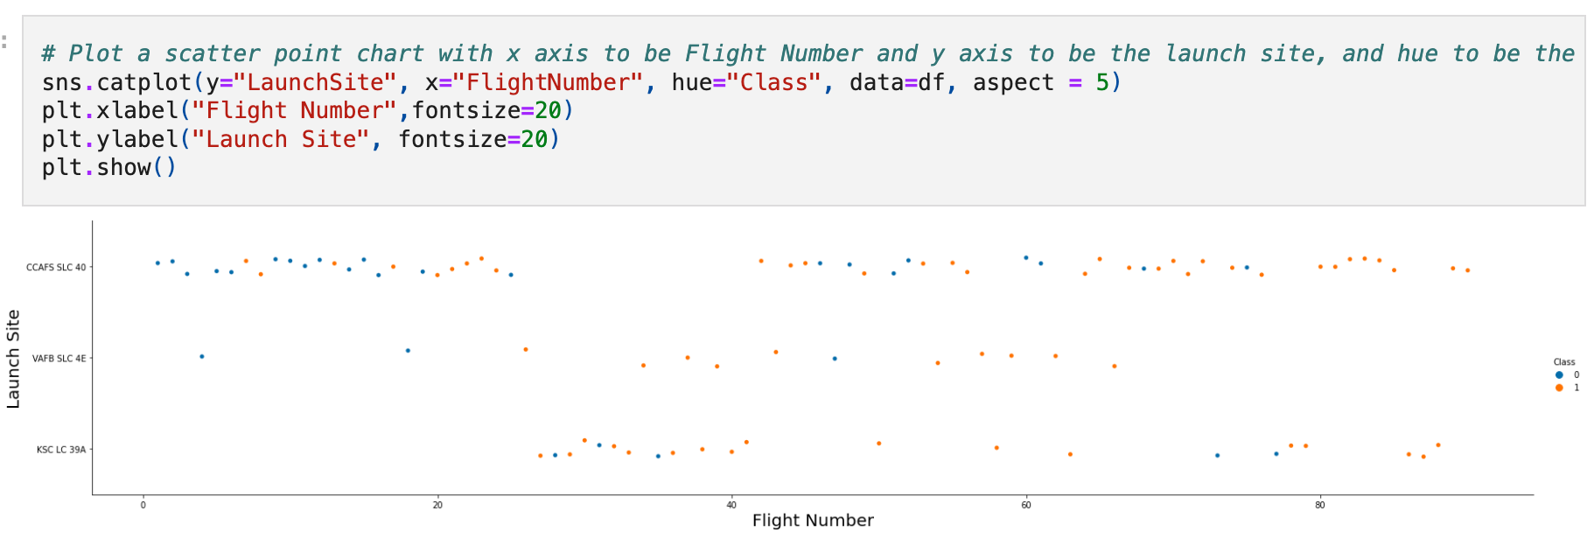
Flight Number vs. Launch Site
An analysis of the Payload vs. Launch Site scatter plot reveals that no rockets with payloads exceeding 10,000 pounds have been launched from the VAFB-SLC site. With that being said, the analysis revealed a positive correlation between the number of flights at a launch site and its overall success rate.

Slide 19
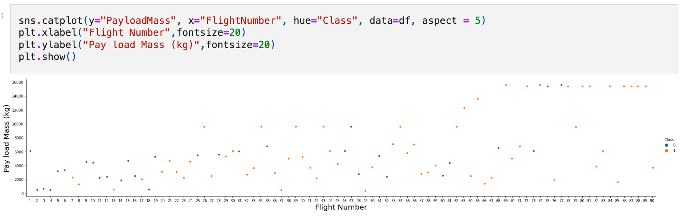
Payload vs. Launch Site
The plot revealed a positive correlation between the payload and launch site. The greater the mass for launch site, the higher the success rate for the rocket.

Slide 20
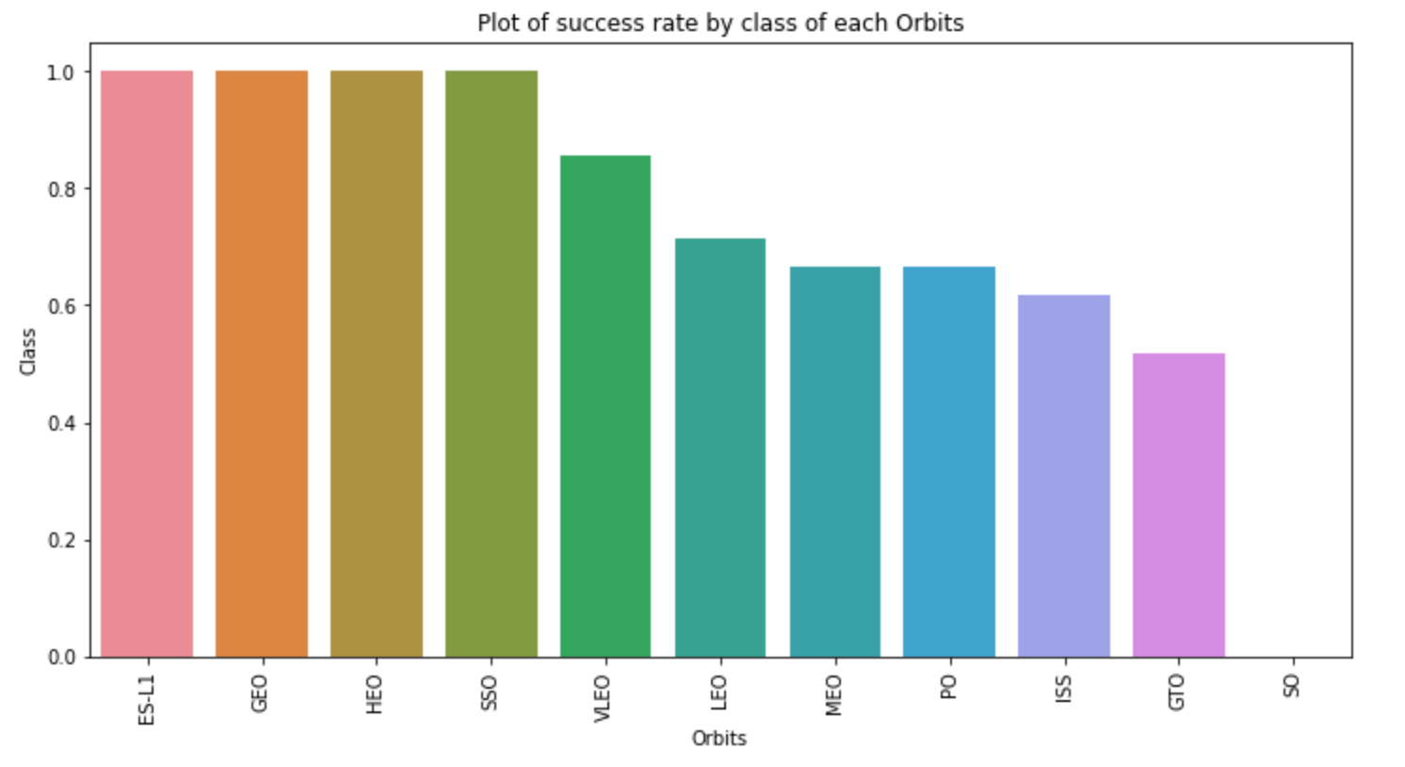
Success Rate vs. Orbit Type
Upon reviewing the plot, it is evident that the ES-L1, GEO, HEO, SSO, and VLEO orbits exhibit the highest success rates. Conversely, the SO orbit demonstrates the lowest success rate among the observed orbits.

Slide 21
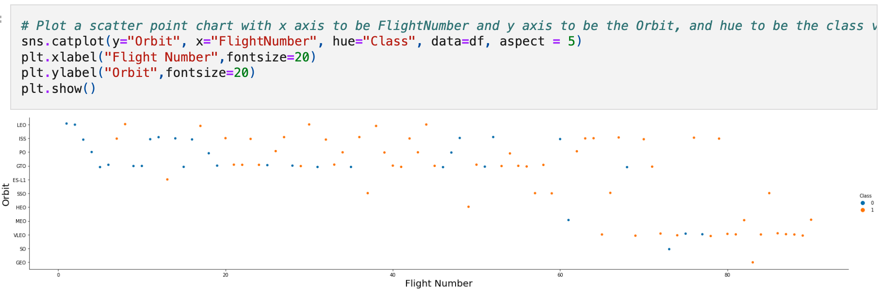
Flight Number vs. Orbit Type
Analysis indicates that in the LEO orbit, success rates appear to correlate with the number of flights conducted. Conversely, no such relationship is observed between flight frequency and success rates in the GTO orbit.

Slide 22
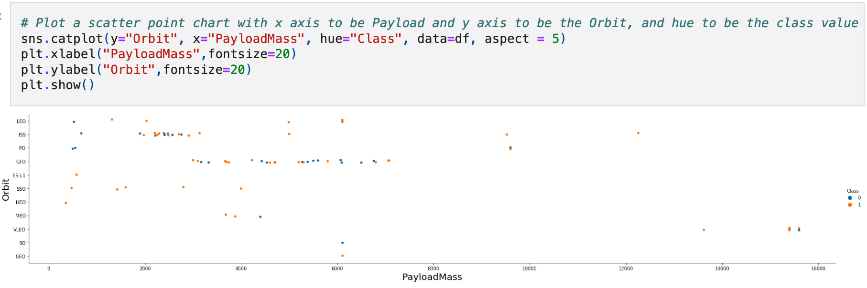
Payload vs. Orbit Type
For heavy payloads, the successful landing rates are notably higher for Polar, LEO, and ISS orbits. In contrast, for the GTO orbit, the data does not clearly distinguish between successful and unsuccessful landings, as both outcomes are observed

Slide 23
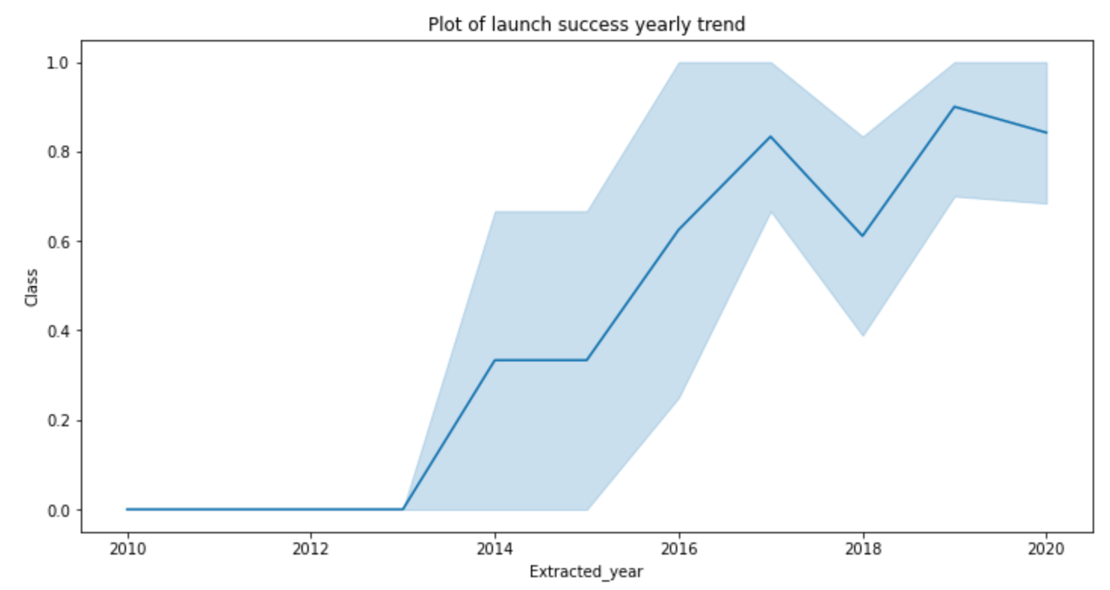
Launch Success Yearly Trend
Since 2013, the success rate has shown a consistent upward trend, peaking in 2020.

Slide 24
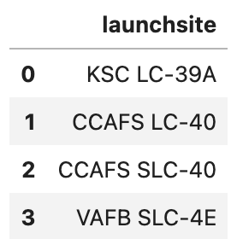
All Launch Site Names
The name of the unique launch site are on the table on the right
There are four launch sites in total

Slide 25
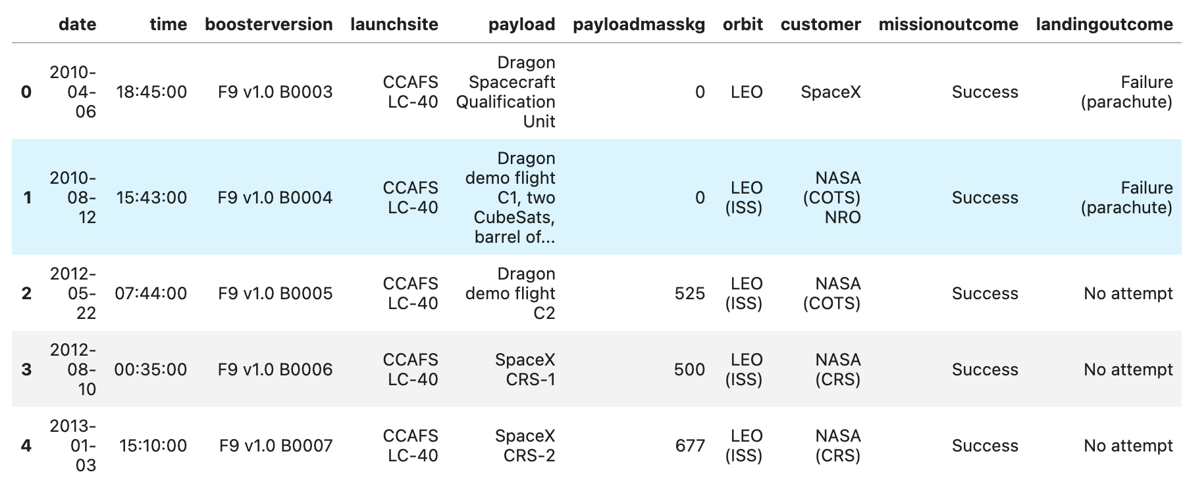
Launch Site Names Begin with 'CCA'
Launch site names begin with ‘CCA’

Slide 26
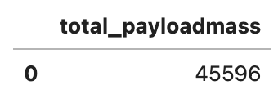
Total Payload Mass
The total payload carried by boosters from NASA (45596) showed on the right screenshot.

Slide 27
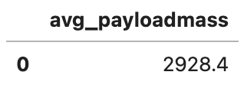
Average Payload Mass by F9 v1.1
The average payload mass carried by booster version F9 v1.1 (2928.4) showed on the right screenshot.

Slide 28
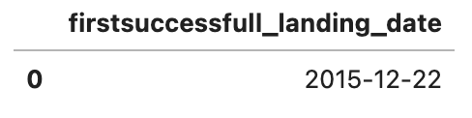
First Successful Ground Landing Date
The dates of the first successful landing outcome on ground pad (2015 – 12- 22) showed on the right screenshot

Slide 29
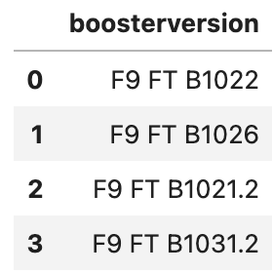
Successful Drone Ship Landing with Payload between 4000 and 6000
The names of boosters which have successfully landed on drone ship and had payload mass greater than 4000 but less than 6000 showed in the right screenshot.

Slide 30
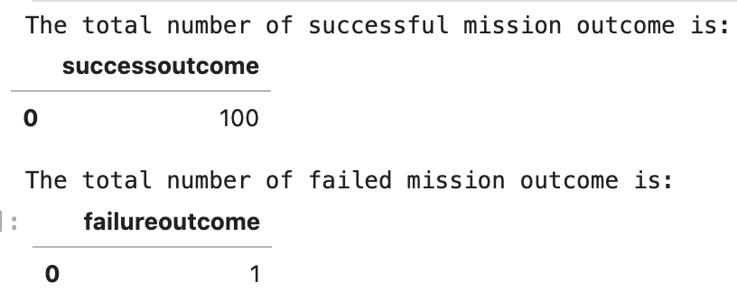
Total Number of Successful and Failure Mission Outcomes
The total number of successful and failure mission outcomes showed in the right screenshot

Slide 31
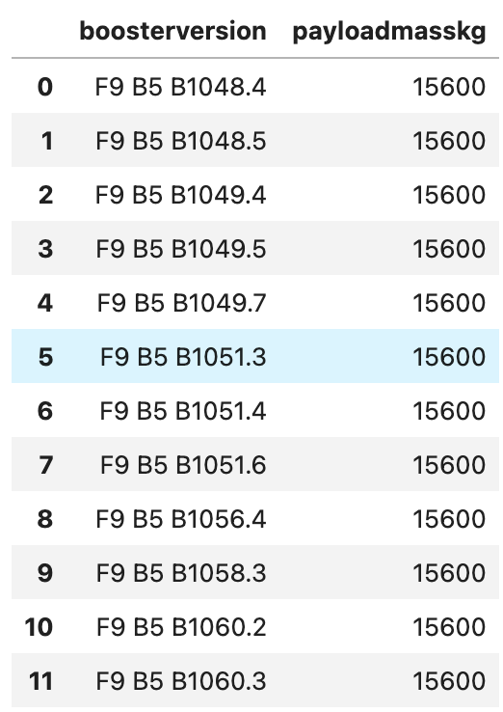
Boosters Carried Maximum Payload
The names of the booster which have carried the maximum payload mass showed in the right screenshot

Slide 32
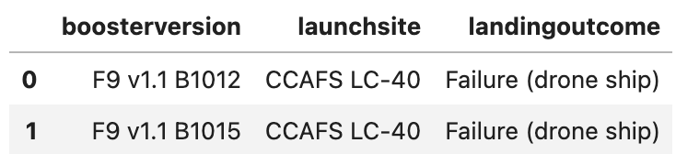
2015 Launch Records
Below are the failed landing_outcomes in drone ship, their booster versions, and launch site names for in year 2015

Slide 33
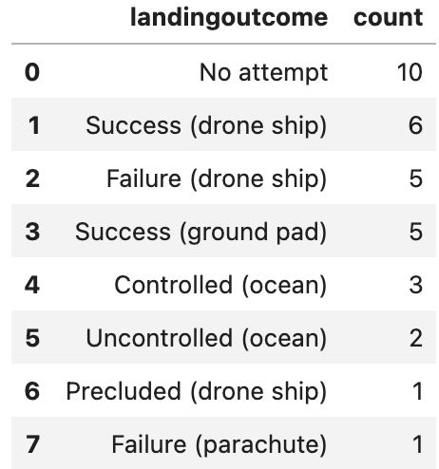
Rank Landing Outcomes Between 2010-06-04 and 2017-03-20
On the right, it shows the the count of landing outcomes (such as Failure (drone ship) or Success (ground pad)) between the date 2010-06-04 and 2017-03-20, in descending order

Slide 34

Section 3

Slide 35

<Folium Map Screenshot 1>

Slide 36

<Folium Map Screenshot 2>

Slide 37

<Folium Map Screenshot 3>

Slide 38

Section 4

Slide 39

<Dashboard Screenshot 1>

Slide 40

<Dashboard Screenshot 2>
Pie chart showing the Launch site with the highest launch success ratio

Slide 41

<Dashboard Screenshot 3>
Scatter plot of Payload vs Launch Outcome for all sites, with different payload selected in the range slider

Slide 42

Section 5

Slide 43
Classification Accuracy
The decision tree classifier is the model with the highest classification accuracy

Slide 44

Confusion Matrix
The confusion matrix for the decision tree classifier indicates that the model effectively differentiates between various classes. However, a significant issue is the prevalence of false positives, where unsuccessful landings are incorrectly classified as successful.

Slide 45
Conclusions
Based on the analysis, we can draw the following conclusions:
Flight Volume and Success Rate: There is a positive correlation between the number of flights conducted at a launch site and the success rate of those launches. Sites with a higher volume of flights tend to exhibit greater success rates.
Trend in Launch Success: The launch success rate demonstrated a steady increase beginning in 2013, continuing through to 2020.
Orbit Performance: The orbits ES-L1, GEO, HEO, SSO, and VLEO consistently show the highest success rates.
Top Launch Site: KSC LC-39A has recorded the highest number of successful launches compared to other sites.
Optimal Machine Learning Algorithm: The decision tree classifier emerges as the most effective machine learning algorithm for this particular task.

Slide 46


